Slide 1

Review of Portfolio Concepts & Asset Pricing Models
Financial Analytics

Slide 2
Portfolio concepts
Mean-variance framework (Chapter 4, Chapter 8)
Minimum variance frontier
Efficient frontier
Capital allocation line (CAL)
Capital market line (CML)
Security market line (SML)
Capital (CAPM) (Chapter 11)
Optimal portfolio
APT (Chapter 11)
Event study

Slide 3
Efficient portfolio
Offering the highest expected return for a given level of risk as measured by variance or standard deviation of return
Minimum-variance portfolio
For each given level of expected return, such portfolio provides minimum variance

Slide 4
Portfolio return: Expected return of two assets A and B
If w₁ and w₂ are weights for two assets, 1 and 2, in a portfolio

Slide 5
Portfolio Risk: Variance of two assets A and B
If w₁ and w₂ are weights for two assets, 1 and 2, in a portfolio

Slide 6
Q: What is the portfolio risk for the 2-asset portfolio, if w1=0.6 and w2=0.4?
Q: What is the portfolio risk for N-asset portfolio? (General formula)

Slide 7
N-asset portfolio

Slide 8
Portfolio risk w₁=0.5, w₂=0.25, w₃=0.25
 |  | std | corr
S&P 500 |  | 20% | 1
US L-T Corp Bond |  | 9% | 0.25 | 1
MSCI EAFE |  | 21% | 0.45 | 0.2 | 1
9%
14%
20%
21%
45%

Slide 9
Portfolio risk w₁=0.5, w₂=0.25, w₃=0.25
 |  | std | corr
S&P 500 |  | 20% | 1
US L-T Corp Bond |  | 9% | 0.25 | 1
MSCI EAFE |  | 21% | 0.45 | 0.2 | 1
Risk: sigma = sqrt (0.019585)=14%

Slide 12
Characteristics about minimum-variance frontiers and diversification
The end points for all of the frontiers are the same
When the correlation is +1, the minimum-variance frontier is an upward-sloping straight line
Diversification has no potential benefit
When the correlation is -1, the minimum-variance frontier has two linear segments
At the global minimum-variance portfolio, standard deviation is zero

Slide 13
Cont’d
For correlation between -1 and +1, the minimum-variance frontier bows out to the left (bullet-like shape)
Comparing to the case of +1 correlation
Any level of expected return can be achieved with less risk
There is a negative slope part, which indicates
If we start from the 100% government bond position, we can achieve higher expected return with less risk

Slide 14
The efficient frontier is the positively sloped part of the minimum-variance frontier

Slide 15
Portfolio choice with a risk-free asset
The standard deviation of return for a risk-free asset is zero
Because the outcome is certain
a certain payoff
The terminal value is certain
Risk-free asset
σ of the risk-free asset is zero
covariance between the risk-free asset and any risky asset is zero.

Slide 16
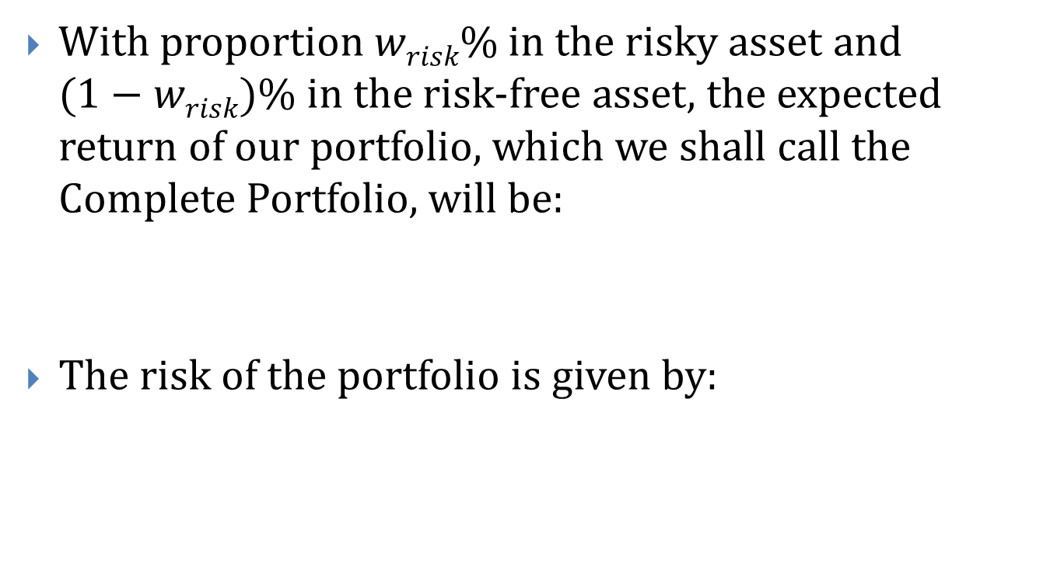
Considering risk-free assets
With proportion $wrisk\%$in the risky asset and $(1−wrisk)\%$in the risk-free asset, the expected return of our portfolio, which we shall call the Complete Portfolio, will be:
The risk of the portfolio is given by:

Slide 18
Tangency portfolio

Slide 19
CAL: Summary
If we can invest in a risk-free asset, then CAL represent best risk-return trade-off achievable
The CAL has a Y-intercept equal to the risk-free rate
The CAL is tangent to the efficient frontier of risky assets

Slide 20
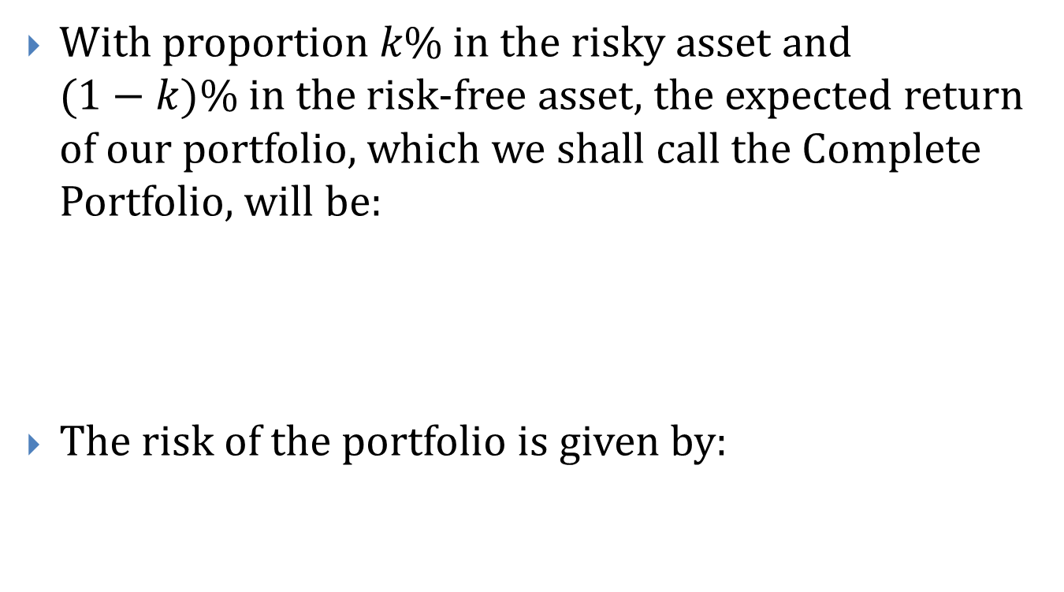
Considering risk-free assets
With proportion $k\%$in the risky asset and $(1−k)\%$in the risk-free asset, the expected return of our portfolio, which we shall call the Complete Portfolio, will be:
The risk of the portfolio is given by:

Slide 21
For the tangency portfolio

Slide 23
CAL
CAL has a slope of
Reward-to-Variability Ratio
CAL shows one simple fact
Increasing the amount invested in the risky asset increases the expected return by a certain risk premium

Slide 24
Capital Market Line (CML)
When investors share identical expectations about
Mean return
Variance of return
Correlation of risky assets
The CAL for all investors is the same and is known as
Capital Market Line (CML)

Slide 25
Cont’d
In equilibrium, the tangency portfolio
Should be offered to investors regardless of their degree of risk aversion
Is optimal risky portfolio
Contain all risky assets in proportions reflecting their market value weights
Market portfolio of all risky assets

Slide 26
Equation for CML
is called market price of risk

Slide 27
CAPM: Assumptions
Identical views about risky asset’s mean returns, variances of returns, and correlations
Can buy and sell in any quantity without affecting price
Can borrow and lend at the risk-free rate without limit (can short)
Not taxes on return and no transaction costs

Slide 28
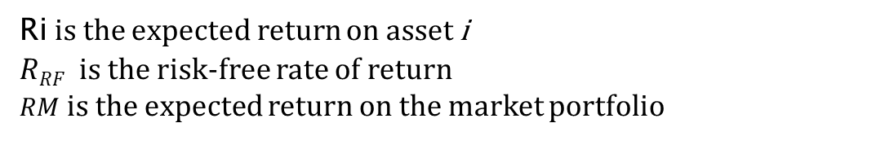
CAPM Equation
R_{i} = R_{RF} + (R_{M} - R_{RF})* β_{i}
Ri is the expected return on asset i
$RRF$ is the risk-free rate of return
$RM$is the expected return on the market portfolio

Slide 29
Implication
https://www.coursera.org/learn/valuation/lecture/6Oh5F/2-2-capital-asset-pricing-model-its-all-about-the-discount-rate
Expected return is a function of
Beta
Most stocks have betas in the range of 0.5 to 1.5
Risk free return
Market return
CAPM serves as a benchmark
Against which actual returns are compared
Against which other asset pricing models are compared

Slide 30
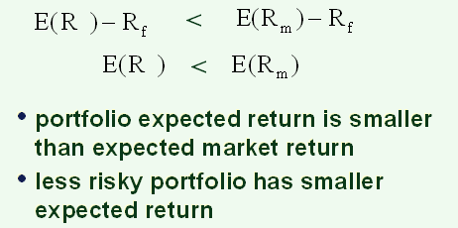
so if β <1,

Slide 31
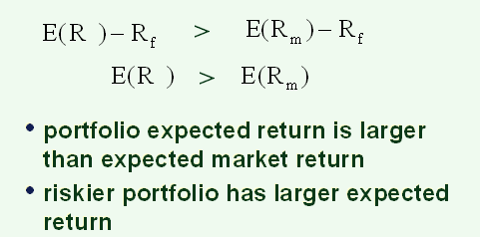
so if β >1,

Slide 32
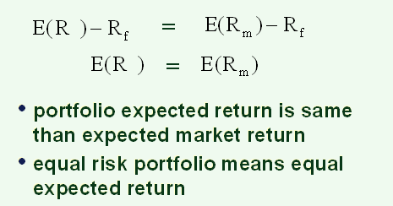
so if β =1,

Slide 33

Example: Using the CAPM: Finding E(R_{i})
Suppose you have the following information: $R_{f} = 3.5\% E(R_{m})=8.5\%$β_{IBM}=0.75
What should E(R_{IBM} ) be?
Answer

Slide 34
Example: Using the CAPM: Finding β_{i}
Suppose you have the following information: R_{f} = 3.5% E(R_{m})=8.5% E(R_{IBM})=7.25%
What should β_{IBM} be?
Answer:

Slide 35
Pros and Cons
Advantages:
Simplicity
Works well on average
Disadvantages:
Makes many simplifying assumptions about markets, returns and investor behavior
How do you estimate beta? Can all aspects of risk be summarized by beta?
What is the true market portfolio and risk free rate?

Slide 36
Notes on Estimating β
Let R_{it}, R_{mt} and R_{ft} denote historical returns for the time period t=1,2,...,T.
Standard way to estimate historical βs using regressions:
Use the Market Model
R_{it} - R_{ft}= α_{i} + β_{i} *(R_{mt} - R_{ft}) +ε_{it}

Slide 37
Choices in estimating Betas
Regression: usually at least 60 observations.
Historical periods of different length: one, two, ...five,... years?
eg: Yahoo Finance!: 60 monthly observations.
Eg: Value line: 260 weekly observations.
Different holding periods: daily, weekly, monthly, annual returns?
More frequent (like daily) --more data, but also more noise.

Slide 38
Choices in estimating Betas: Cont.
Risk free rate: short term or long term?
Long term used because (1)equities are long term instruments, and (2)there is less volatility in long term rate.
Market risk premium: ex-post or ex-ante?
Ex-post from Ibbotson
Ex-ante from IBES (Will vary over time)
CRSP historic market risk premium
What indexes are used to represent R_{m}?
S&P500, NYSE index, Russell 3000, CRSP Market return, etc

Slide 39
CONCLUSION of BETA
One can calculate Betas in many ways; depending on the method used, different betas may result from CAPM:
R_{i} = R_{RF} + (RP_{M}) * β_{i}
or R_{i} = R_{RF} + (R_{M} - R_{RF})* β_{i}
With luck, different Betas from different sources will be close.
Finance academia and industry: use Fama French/CRSP dataset

Slide 40
SAS: CAPM Regression Example
CAPM model
R_{it} – R_{RF,t} = intercept_{i} + (R_{Mt} – R_{RF,t})* β_{i,t} + error_{it}
Google
Data: Daily data 2014-2015
Data source: Fama French Library (stock return; market return and risk free rate)
Software: SAS

Slide 41
SAS: CAPM Regression Example Cont.
Analysis of Variance
Source | DF | Sum of Squares | Mean Square | F Value | Pr > F
Model | 1 | 0.04598 | 0.04598 | 279.88 | <.0001
Error | 502 | 0.08248 | 0.00016430
Corrected Total | 503 | 0.12846
Adj R sq: % variance of Y can be explained by Xs.
Root MSE | 0.01282 | R-Square | 0.3580
Dependent Mean | 0.00077297 | Adj R-Sq | 0.3567
Coeff Var | 1658.27866
Parameter Estimates
Variable | DF | Parameter Estimate | Standard Error | t Value | Pr > |t|
Intercept | 1 | 0.00054302 | 0.00057112 | 0.95 | 0.3422
mrp | 1 | 1.14708 | 0.06857 | 16.73 | <.0001
alpha
Beta

Slide 42
Interpreting Regression Results
The regression line, and the coefficient of X variable, is the beta value.
The R² measures the percent of a stock’s variance that is explained by the market. The typical R² is:
0.3 for an individual stock
over 0.9 for a well diversified portfolio
Examples of SAS regression analysis with footnotes explaining the output: http://www.ats.ucla.edu/stat/sas/output/reg.htm
(advanced: autoreg) https://support.sas.com/rnd/app/ets/examples/capm/index.htm

Slide 43
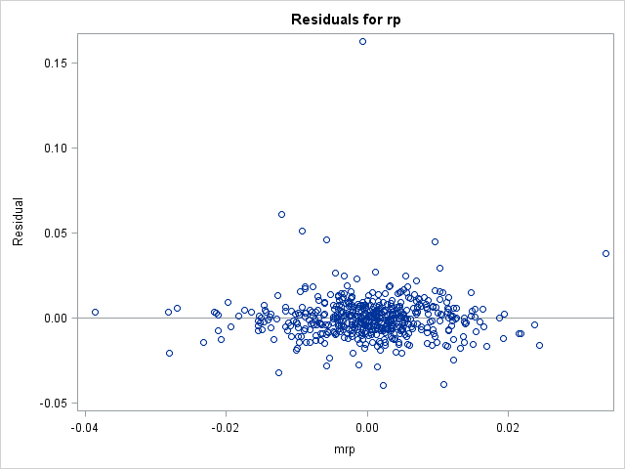
SAS: CAPM Regression Example Cont.

Slide 44
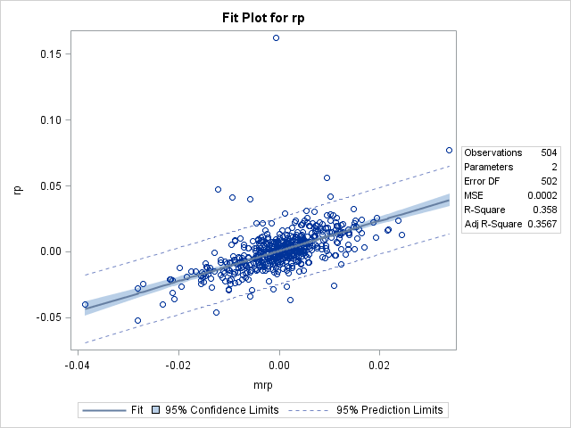
SAS: CAPM Regression Example Cont.
outlier

Slide 45
Arbitrage Pricing Theory (APT)
1976, Ross
assume:
several factors affect E(R)
does not specify factors

Slide 46
APT
E(R) is a function of several factors, F, each with its own β

Slide 47
CAPM vs. APT
APT is more general
many factors
unspecified factors
CAPM is a special case of the APT
1 factor
factor is market risk premium

Slide 48
Fama-French 3-factor model
http://www.investopedia.com/terms/f/famaandfrenchthreefactormodel.asp
http://mba.tuck.dartmouth.edu/pages/faculty/ken.french/data_library.html
Fama and French found that the market risk premium from CAPM can explain 75% of stock return; and their three factors can explain 90% of stock return.
Fama and French propose three factors:
X variable: the excess market return, R_{M}-R_{F}.
The return on, S, a portfolio of small firms (where size is based on the market value of equity) minus the return on B, a portfolio of big firms.
SMB for S minus B
The return on, H, a portfolio of firms with high book-to-market ratios (using market equity and book equity) minus the return on L, a portfolio of firms with low book-to-market ratios.
HML for H minus L

Slide 49
Fama-French 3-factor model Cont’d
Βsmb
If > 0, the stock has higher expected returns if small-cap stocks outperform large-cap stocks (the stock is predominantly small-cap )
If < 0, the stock has higher expected returns if large-cap stocks outperform small-cap stocks (is predominantly large-cap )
βhml
If > 0, the stock has higher expected returns if high book-to-market (i.e., value) stocks outperform low book-to-market (i.e., growth) stocks, (is predominantly value stocks)
If <0, the stock has higher expected returns if low book-to-market (i.e., growth) stocks outperform high book-to-market (i.e., value) stocks, (is predominantly growth stocks).

Slide 50
Fama-French 3-factor model Example
Google
Data: Daily data 2014-2015
Data source: Fama French Library (stock return; market return and risk free rate)
Software: SAS

Slide 51
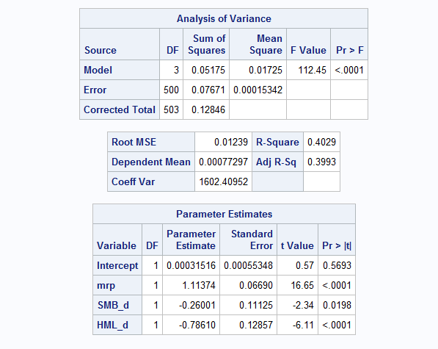
Fama-French 3-factor model Example Cont.
Adj R-sq bigger than that of CAMP.
Model is improved.
A negative b(SMB )→ Google is a large firm
A negative b(HML )→ Google is a growth firm

Slide 52
Event study: An advanced topic for APT Application
Estimation period
Event windows
Event day
Estimate parameters
Expected return
Abnormal return
Actual return

Slide 53
Event study (1st step)
Subtract n (such as 46) days from the event date, and the resulting day is the last day of the estimation period
For each firm i, estimate the market model coefficients using daily returns for the 255-day estimation period

Slide 54
Event study (2nd step)
Test the significance of abnormal return

Slide 55
Event study (3rd step)
Using abnormal return surrounding event windows for each event, we can perform regression analysis to test what factors may affect the abnormal return

